Slide 1
10. Support Vector Machine (SVM)
Youngsoo Kim <pineland@hanmail.net>
Code : https://github.com/pineland/AIDA/

Slide 2
Contents
What is a Support vector machine (SVM)?
How to make the model(w, b) of SVM?
Optimization of SVM
Linearly non-separable cases
Soft-margin SVM
Kernel SVM
Applications of SVM
Advantages vs. Disadvantages of SVM

Slide 3
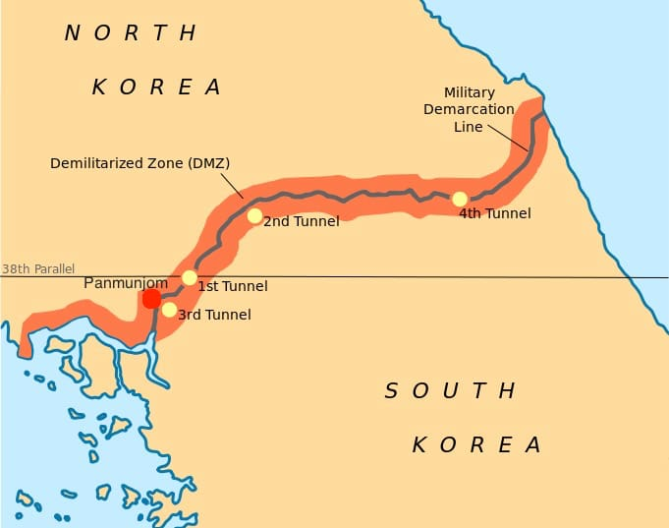
Why DMZ ?

Slide 4
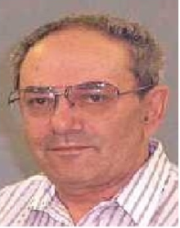
What is a Support vector machine (SVM)?
Suggested by Vladimir N.
Vapnik in 1995.
Good at finding the best linear separator.
Can be used a kernel trick to classify non-linear separated datasets.
Based on fancy statistical learning theory.
Trained with a learning algorithm from optimization theory (Lagrange)

Slide 5
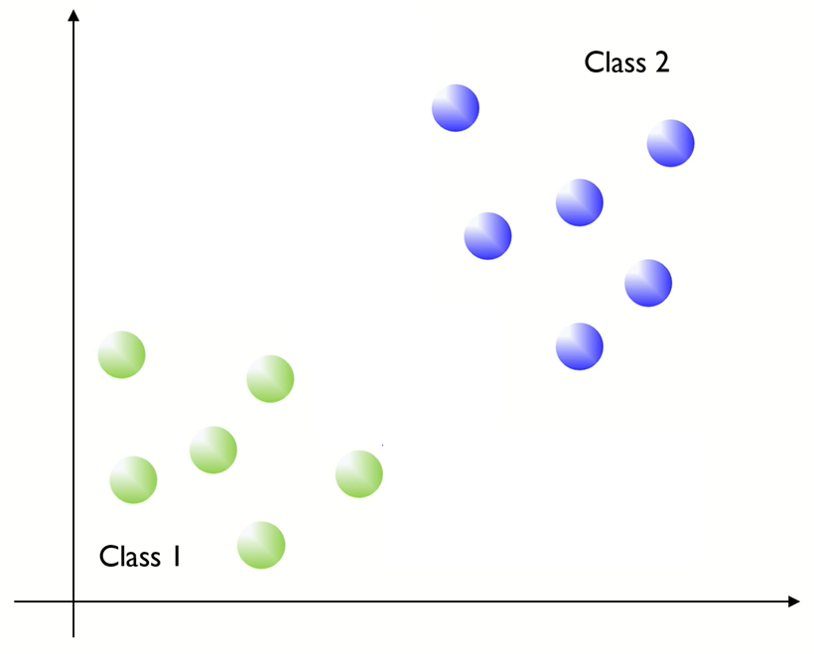
Basic idea
How to divide the space with an optimal decision boundary?

Slide 6
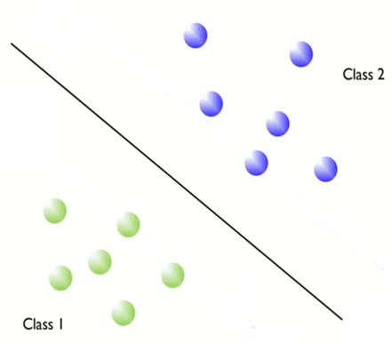
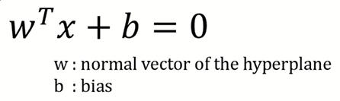
How to make the optimal line ?
Widest street strategy
Maximize the margin over the training set.
Margin
Support vectors

Slide 7
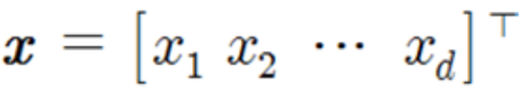
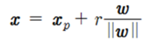
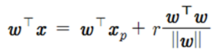
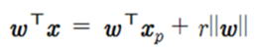
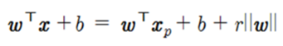
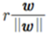
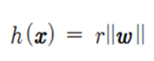
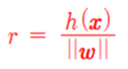
Margin (r)
Input data
Hyperplane
…①
…②
Notes:
* w는 h의 법선벡터(weight vector).
* ro는 x가 원점이라고 간주하여 h와의 거리를 계산하면 됨.

Slide 8
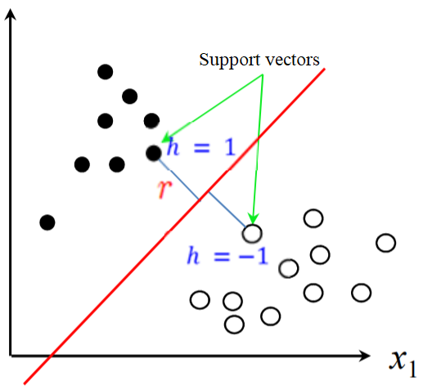
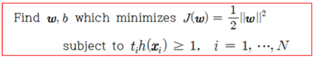
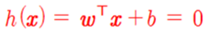
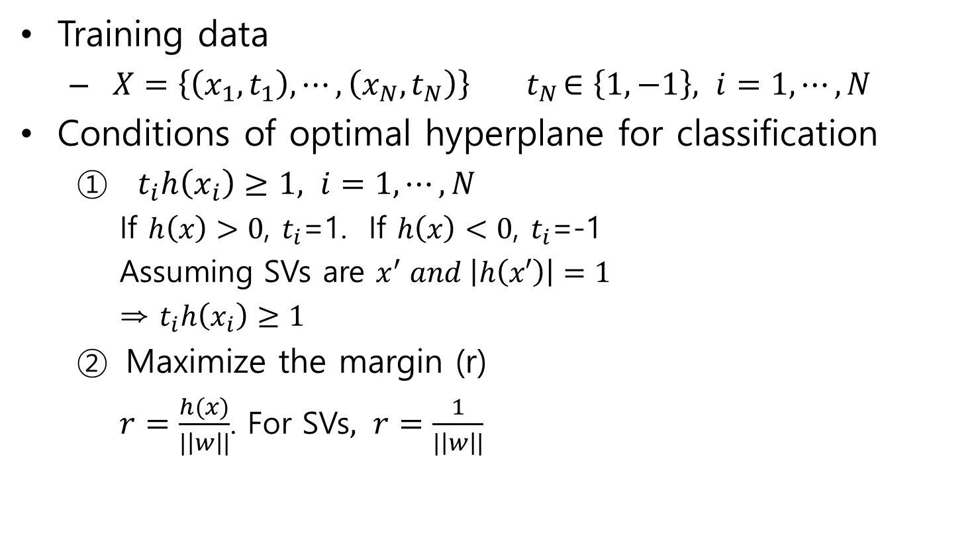
Training of SVM
Training data
$X=\left\{\left(x_{1},t_{1}\right),⋯,\left(x_{N},t_{N}\right)\right\}{ t}_{N}∈\left\{1,−1\right\}, i=1, ⋯, N$
Conditions of optimal hyperplane for classification
$t_{i}h\left(x_{i}\right)≥1, i=1, ⋯, N$
If $h\left(x\right)>0$, $t_{i}$=1. If $h\left(x\right)<0$, $t_{i}$=-1
Assuming SVs are $x^{′} and \left|h\left(x′\right)\right|=1$
⇒ $t_{i}h\left(x_{i}\right)≥1$
Maximize the margin (r)
$r=\frac{h(x)}{|\left|w\right||}$. For SVs$, r=\frac{1}{|\left|w\right||}$
☜ 학습데이터를 모두 제대로 분류한다.
…③
…④
Notes:
* 식 ⑤에서 거리의 개념으로 봐서 h(x) = 1

Slide 9
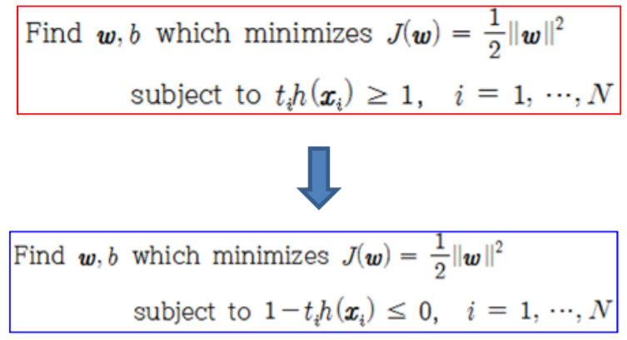
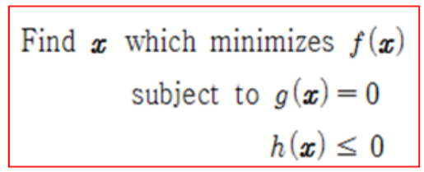
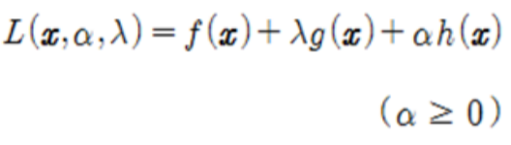
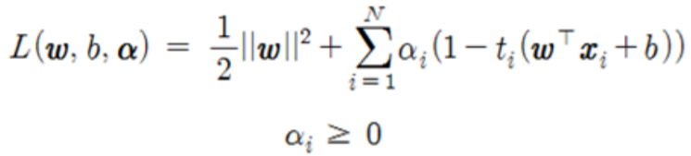
Optimization of SVM
Optimization of the Constraint condition
<Lagrangian theory>
- Lagrangian formula
- Lagrangian formula (Primal problem)
…⑤

Slide 10
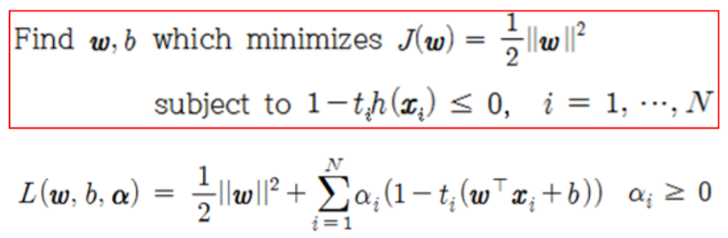
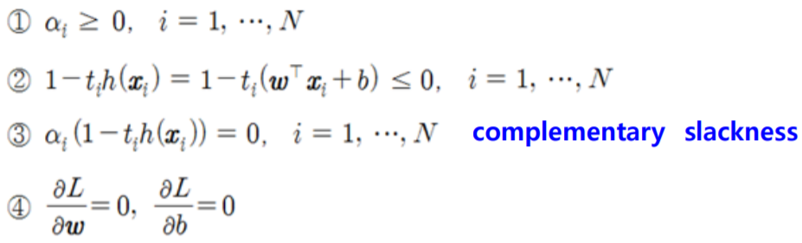
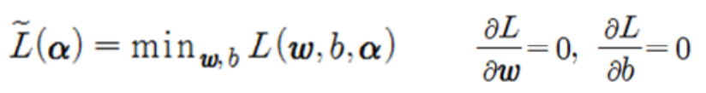
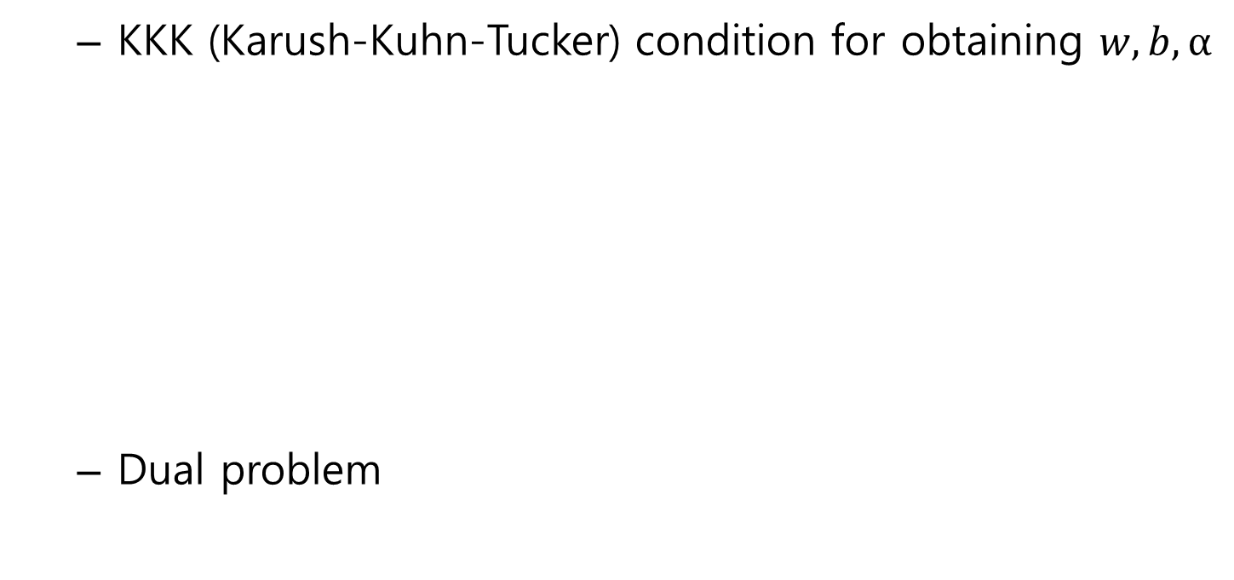
…⑤
KKK (Karush-Kuhn-Tucker) condition for obtaining $w, b, α$
Dual problem
…⑥

Slide 11
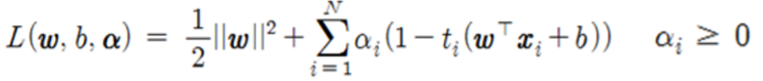
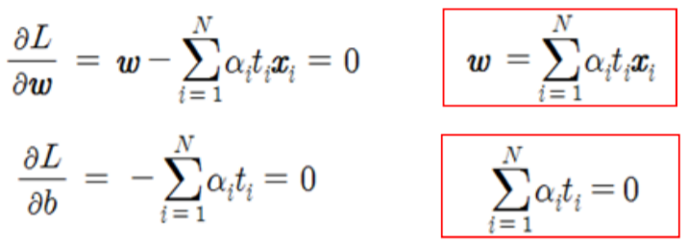
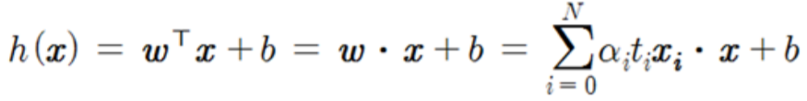
Lagrangian formula
Dual function
Let differentiate the eq. ⑤ and substitute to the eq. ⑥.
Hyperplane equation
…⑤
…⑥
…⑦
…⑧
…⑨

Slide 12
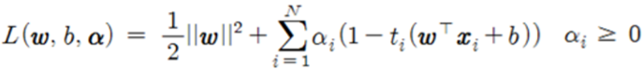
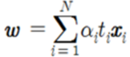
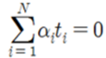
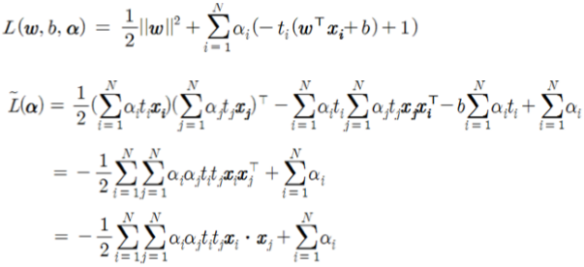
Lagrangian formula
Put the Eq. ⑦,⑧ into the Eq. ⑤ and develop as follows:
…⑤
…⑦
…⑧
…⑪

Slide 13
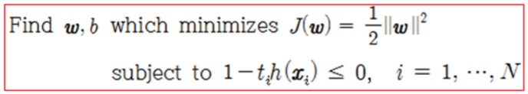
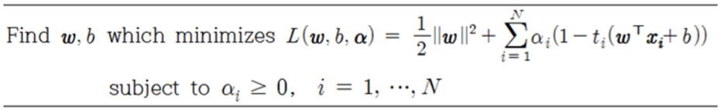
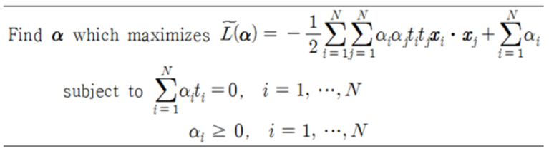
Optimization problem of SVM
Primal problem described by Lagrangian formula
Dual problem not having w and b
* Problem complexity
- Only depends on
the number of data

Slide 14
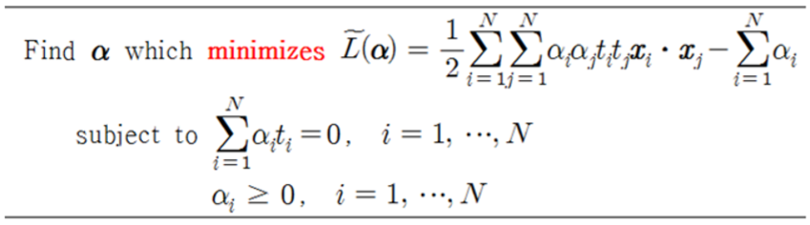
Conversion of the dual problem
Maximization -> Minimization
Quadratic programming problem

Slide 15
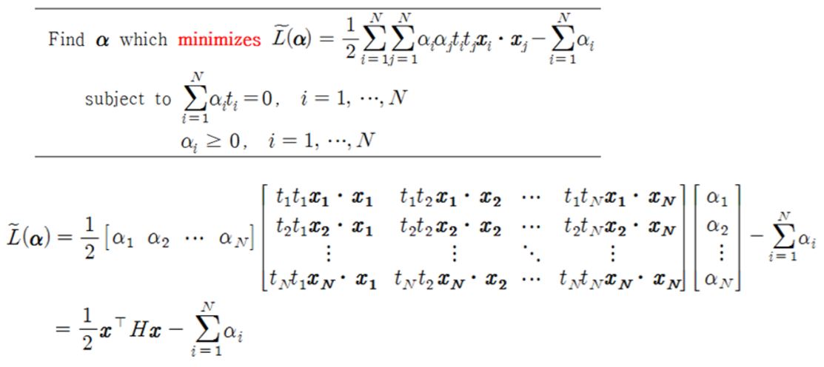
Quadratic programming
Use quadratic problem solver libraries of linear algebra to get α.
Python : cvxopt.solvers.qp()

Slide 16
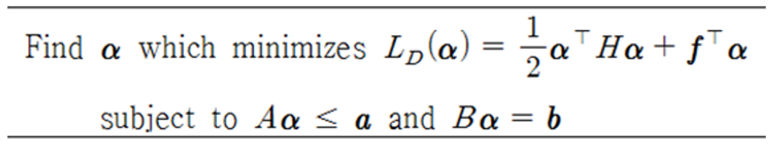
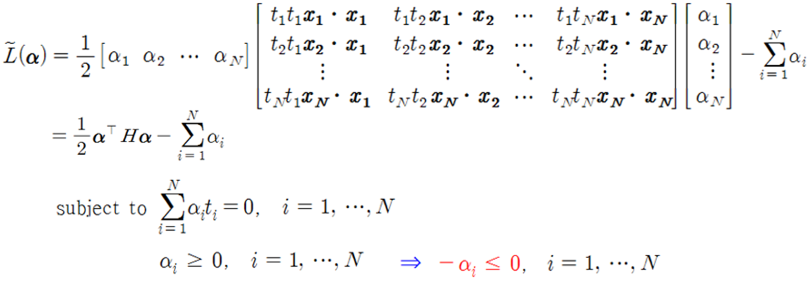
Canonical form of quadratic programming
α = cvxopt.solvers.qp(H, f, A, a, B, b)
Dual problem of SVM
H
f
B
b
A
a

Slide 17
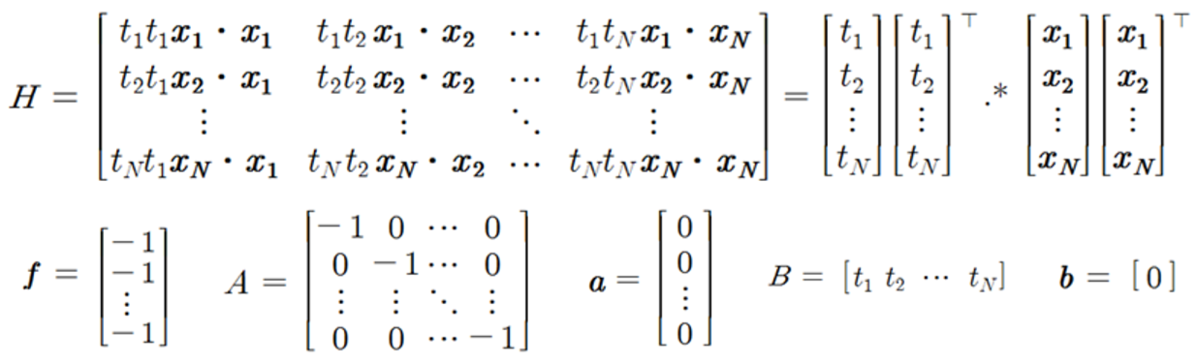
Dual problem of SVM

Slide 18
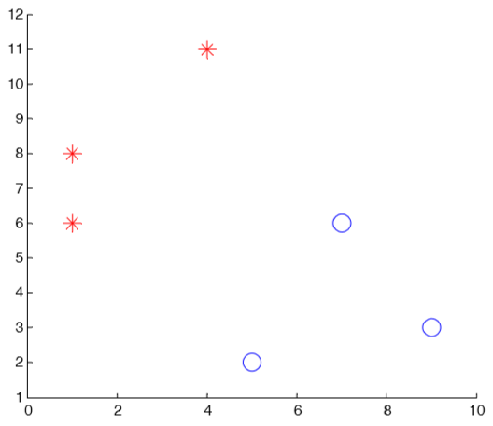
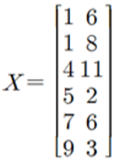
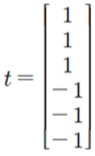
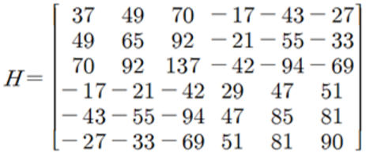
Example of solving dual problem
Class 1 (+1) : (1,6), (1,8), (4,11)
Class 2 (-1) : (5,2), (7,6), (9,3)
Input data
Output
Matrix H
H = (X * X’) .* (t * t’)

Slide 19
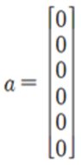
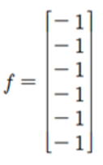
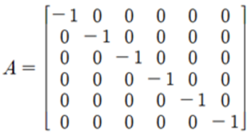
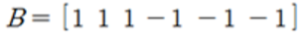
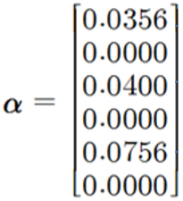
f = matrix(-np.ones((6,1), dtype=np.float64))
A = matrix(-np.eye(6, dtype=np.float64))
a = matrix(np.zeros((6,1), dtype=np.float64))
B = matrix(np.transpose(t))
b = matrix(np.array([0.]))
alphas = np.array(solvers.qp(H, f, A, a, B, b)['x'])

Slide 20
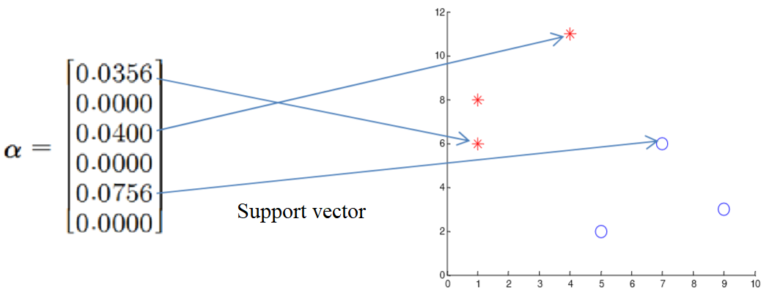






If $α_{i}≠0$, $h\left(x_{i}\right)=1$ because of $α\left(1−h\left(x_{i}\right)\right)=0$ in the KKT condition.
$x_{i} with α_{i}≠0$ are support vectors.
Calculate $w$
Calculate $b$
pick a SV([1 6]) and calculate.

Slide 21





Finally we can get the hyperplane (decision equation) as follows:

Slide 22

Linearly non-separable case

Slide 23


Soft-margin SVM (Linearly non-separable case #1)
It is impossible to classify perfectly. So, allow some errors.
A slack variable $ξ$ is the allowed error value of the training data. $ξ$ ≥ 0.

Slide 24




Slack variable ($ξ$)
If a data is more towards its class than SV, $ξ$ = 0
In other cases, $ξ_{i}=|t_{i}−h\left(x_{i}\right)|$

Slide 25



Optimization of Soft-margin SVM
Constraints allowing the slag variables
Minimize the sum of the values of the slag variables
Lagrangian formula
Cost(reflection
ratio of $ξ$)

Slide 26


Lagrangian formula
Dual problem
Add Constraint to Upper Limits
“Almost same as the dual problem of the linear SVM
without Add Constraint”

Slide 27

C (cost) is a tuning parameter that determines trade-off between the margin and training errors.
C ↑ : doesn’t allow much training error. (over-fit)
C ↓ : allow much training error. (under-fit)

Slide 28

Kernel SVM (Linearly non-separable case #2)
Problem of hyperplane of the linear SVM
Not applicable to nonlinear decision boundary between classes because the hyperplane is “linear” even if a slag variable is applied.
How?

Slide 29



High-dimensional mapping : transforming data

Slide 30

Example of transforming data
Problem of transforming high dimensional data
Curse of dimensionality
Increase computational cost
Use “kernel trick”

Slide 31





Linear SVM
Non-linear SVM
high-dimensional transforming

Slide 32


Kernel trick
$Φ(x_{i})∙Φ(x_{j})$ is calculated from the original data, not converting to a higher dimension.
Use kernel function K that can make calculation possible without converting to a higher dimension.
$K\left(x_{i},x_{j}\right)=Φ(x_{i})∙Φ(x_{j})$
e.g. of kernel function
Converting to
a higher dimension
(Unused)
Kernel trick

Slide 33






Commonly used kernel functions
Polynomial kernel
RBF (radial basis function) kernel
Sigmoid (=Hyperbolic tangent)
kernel

Slide 34



RBF (radial basis function) kernel
* As C and gamma$(γ)$
become larger,
a more detail model
is made.

Slide 35


Optimization when applying kernel function
Applying kernel function

Slide 36



Determine hyperplane
Linear SVM
Non-linear SVM
Use quadratic programming libraries to get α.
Python : cvxopt.solvers.qp()
h(x) can be defined with α, t, and x.
☜ Actually, only SVs (α_{i}≠0) are used.

Slide 37

Hyperplane and SVs in non-linear SVM
Hyperplane

Slide 38
Applications of SVM
SVM has been used successfully in many real-world problems
Text (and hypertext) categorization
Image classification
Bioinformatics (Protein classification, Cancer classification)
Hand-written character recognition
etc.

Slide 39

Advantages of SVM
Shows good performance
for real world data.
Work well on small as well as high dimensional data spaces.
the complexity is generally characterized by the number of support vectors rather than the dimensionality.
Work effectively on small training datasets
SVM doesn’t rely on the entire data.
DNN
SVM

Slide 40
Disadvantages of SVM
Takes a long time for training
the training time with SVMs can be high and much more computationally intensive.
Not suitable for larger datasets
Sensitive noise
Less effective on noisier datasets that have overlapping classes.
Choosing the right kernel function is not easy.
Only consider two classes.
How to do multi-class classification with SVM?
SVM_A learns "Output==A" vs. "Output !=A"
SVM_B learns "Output==B" vs. "Output !=B"
So on.

Slide 41

Q & A

